Slide 1

Week 5

Slide 2
Practice
https://leetcode.com/problems/detect-cycles-in-2d-grid/

Slide 3
Prim’s Algorithm
Is a greedy algorithm
Idea: a spanning tree means all vertices must be connected, so if we have two sets of vertices, one set contains vertices not yet in the MST, the other set contains vertices already in the MST, then vertices in two sets must be connected, with the minimum weight edge
Cut: a group of edges that connects two sets of vertices in a graph

Slide 4
Prim’s Algorithm
Create a set mst_set that keeps track of vertices already included in MST
Create a list key[] of size |V| with all values as infinite except key[src] = 0 where src is the source vertex that will be picked first
While mst_set does not include all vertices
Pick a vertex u that is not in mst_set and has a minimum key value
Add u to mst_set
For every neighbour v of u that is not yet in mst_set, update key[v] = weight(u, v) if weight(u,v) < key[v]

Slide 5
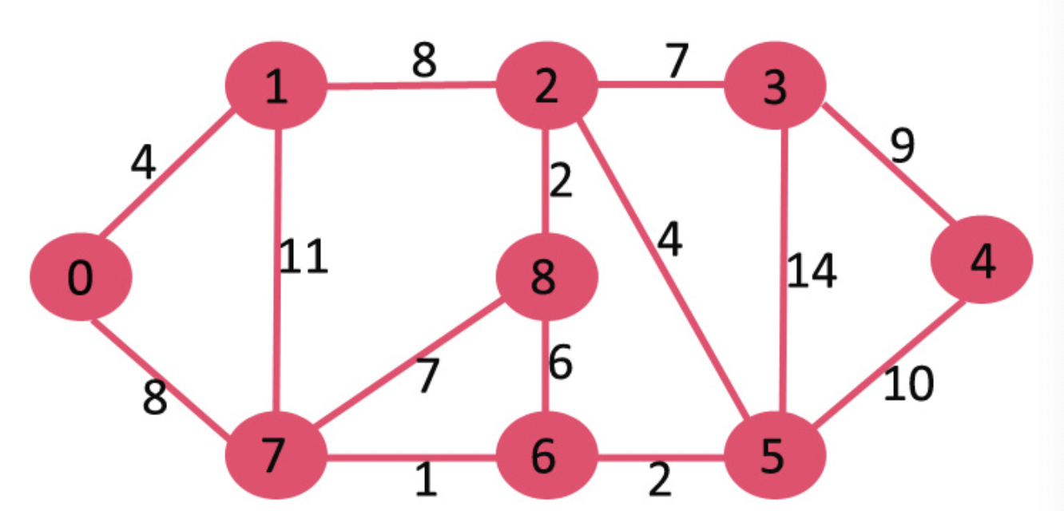

Slide 6
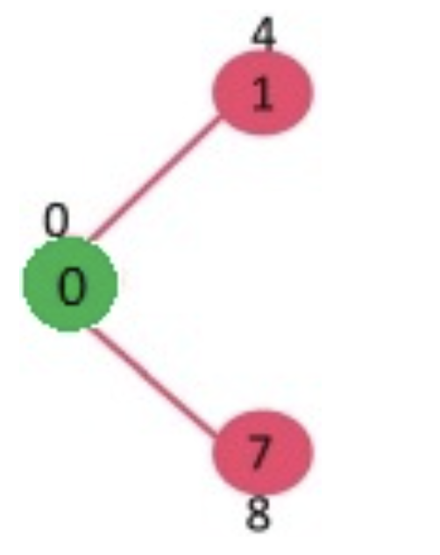

Slide 7
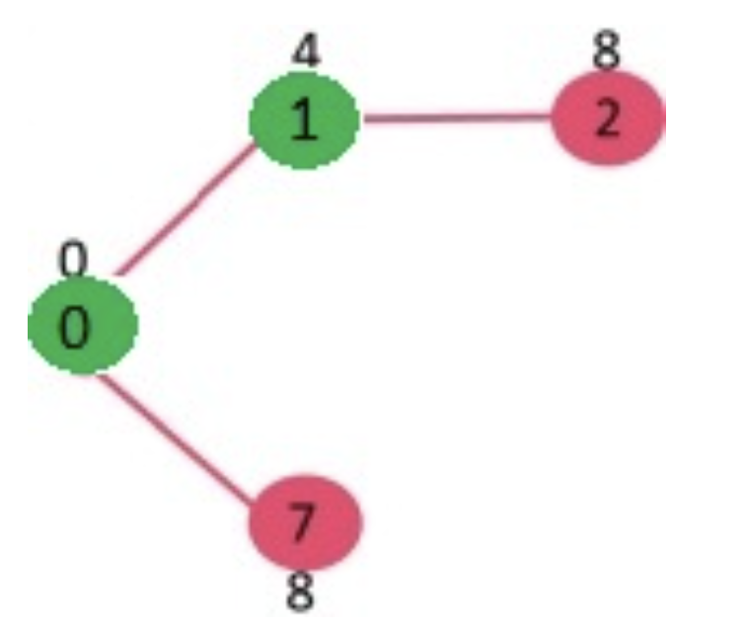

Slide 8
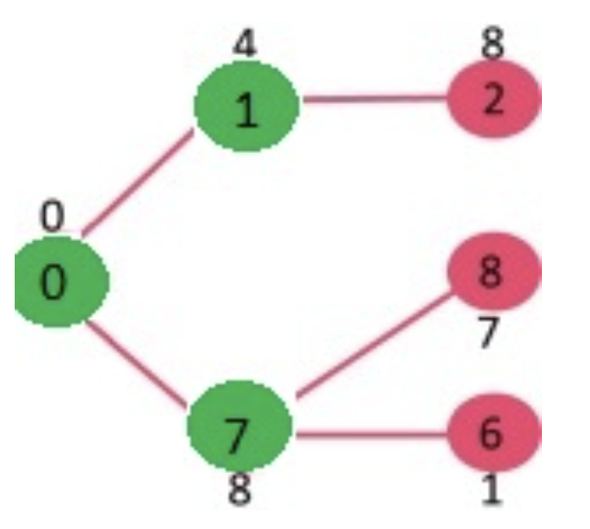

Slide 9
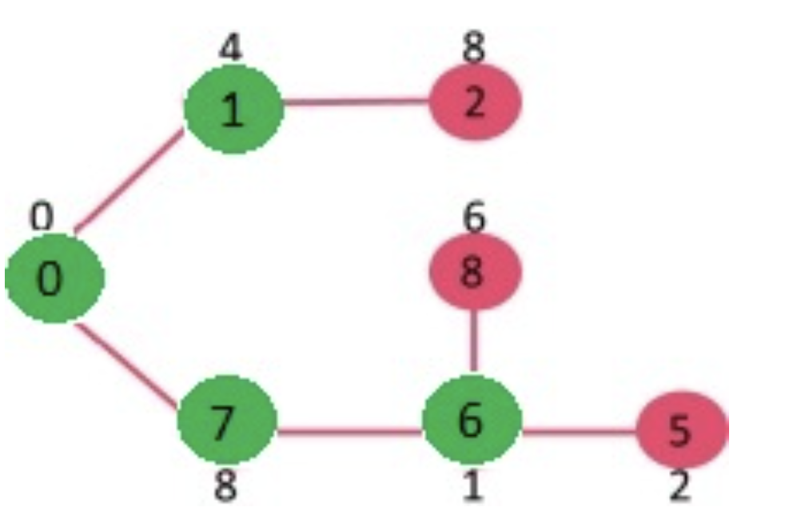

Slide 10
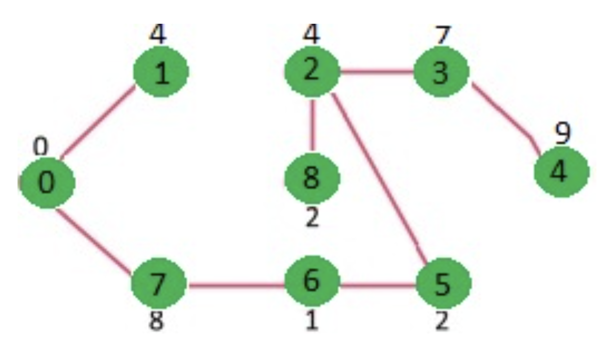

Slide 11
Time Complexity
O(V^2)
Can be reduced to O(E*logV) if adjacency list is used

Slide 12
Prim vs. Kruskal
Kruskal:
Builds an MST by adding one edge at a time
The next line is always the shortest (minimum weight) ONLY if it does not create a cycle
Prim:
Builds an MST by adding one vertex at a time
The next vertex to be added is always one nearest to a vertex already on the graph

Slide 13
Review on Shortest Path Problems
Dijkstra’s: shortest path from one node to all nodes
Bellman-ford: shortest path from one node to all nodes, negative edges allowed
Floyd-Warshall: shortest path between all pairs of vertices, negative edges allowed

Slide 14
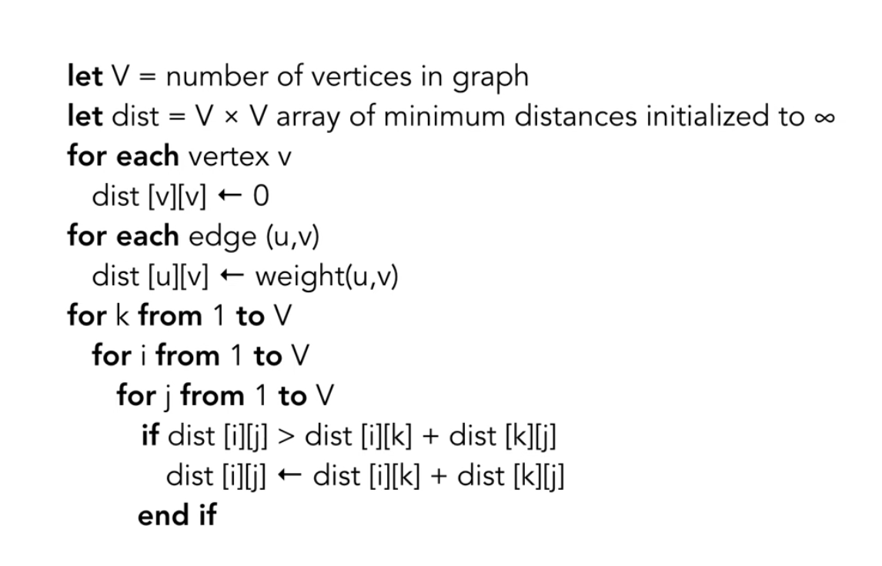

Slide 15
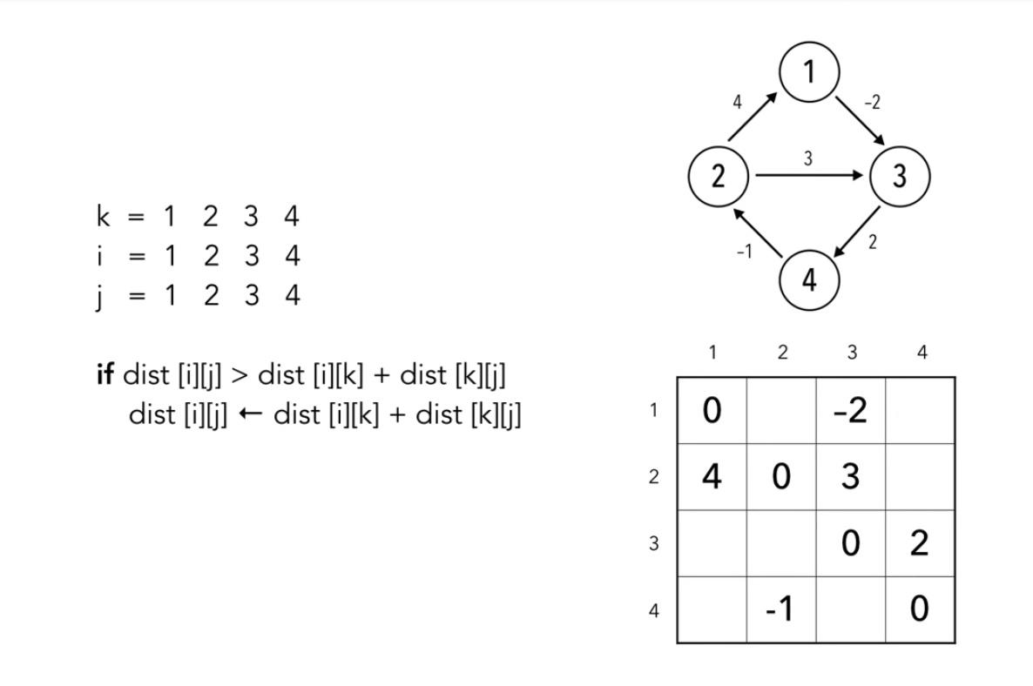

Slide 16
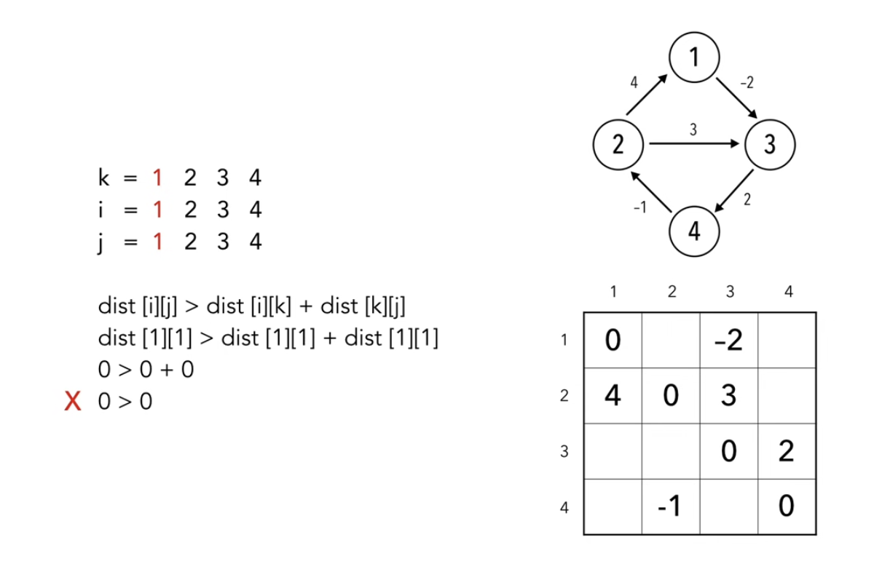

Slide 17
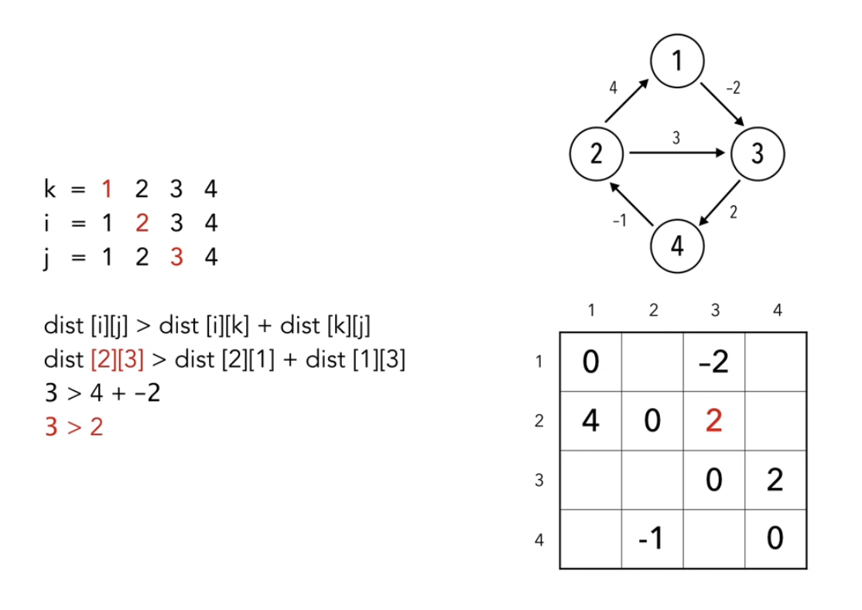

Slide 18
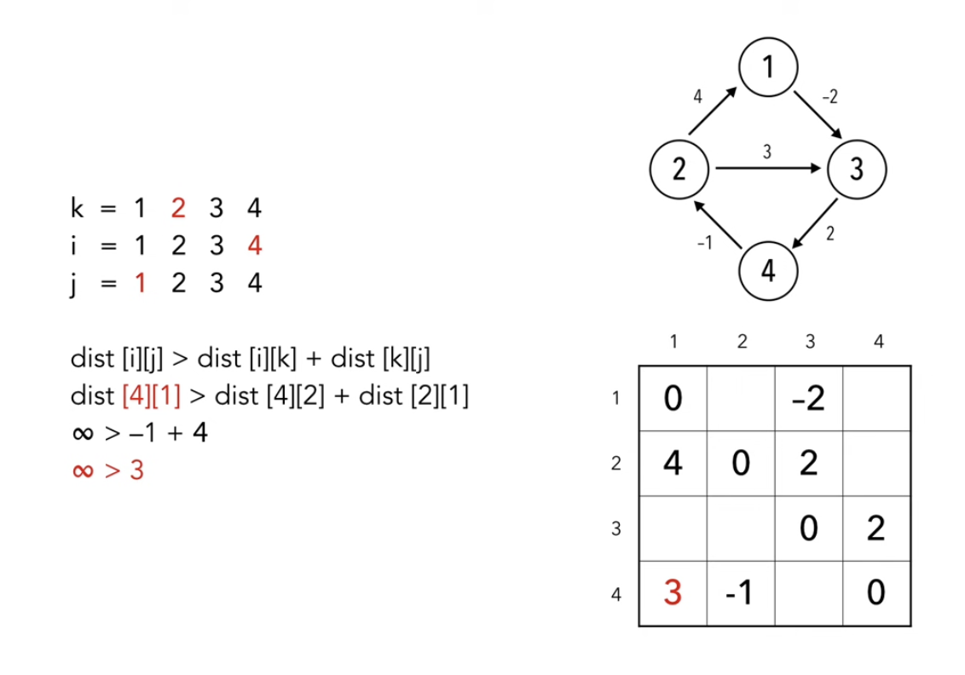

Slide 19
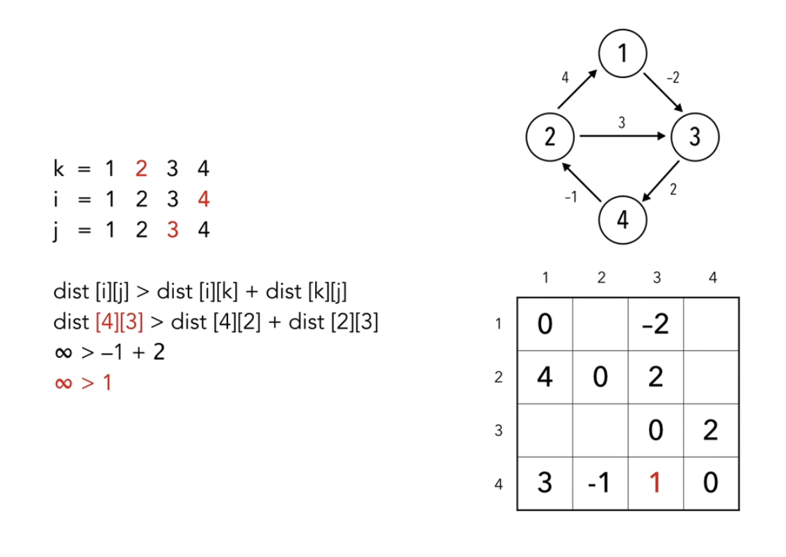

Slide 20
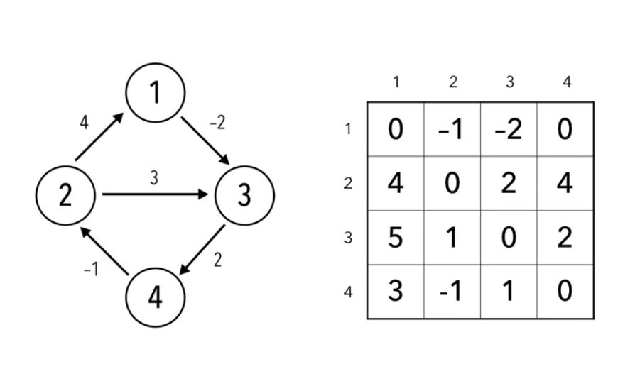

Slide 21
Time Complexity
O(V^3)

Slide 22
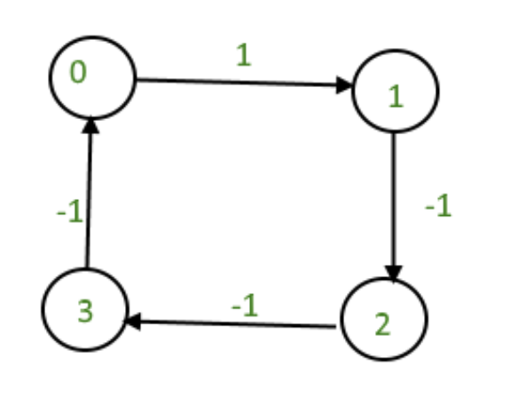
Detecting Negative Cycles
Distance of any node to itself is always zero
If distance of any node to itself becomes negative, then there is a negative cycle

Slide 23
Longest Path
Given a weighted directed acyclic graph and a source vertex v, find the longest distances from v to all other vertices in the given graph
Cannot have positive cycles because longest path will grow infinitely

Slide 24
Longest Path
Idea: find the topological ordering of the graph, then process all vertices in the topological ordering one by one
For every vertex u in the topological order
For every adjacent vertex v of u
If (dist[v] < dist[u] + weight(u, v)), then update dist[v] = dist[u] + weight(u, v)

Slide 25
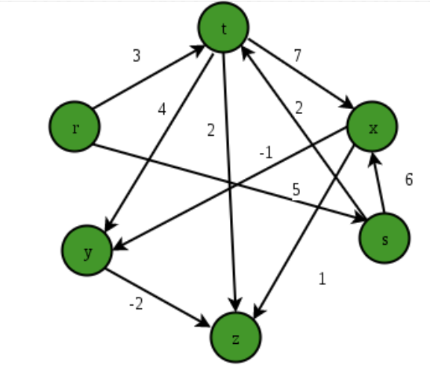

Slide 26
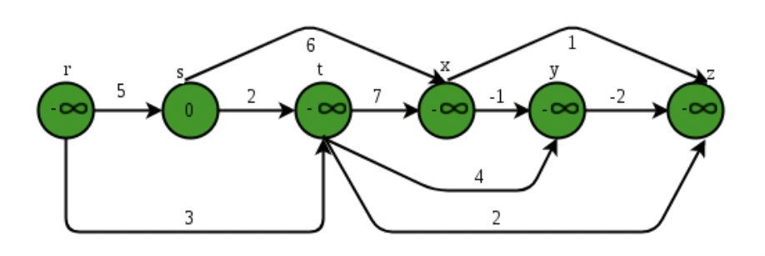

Slide 27
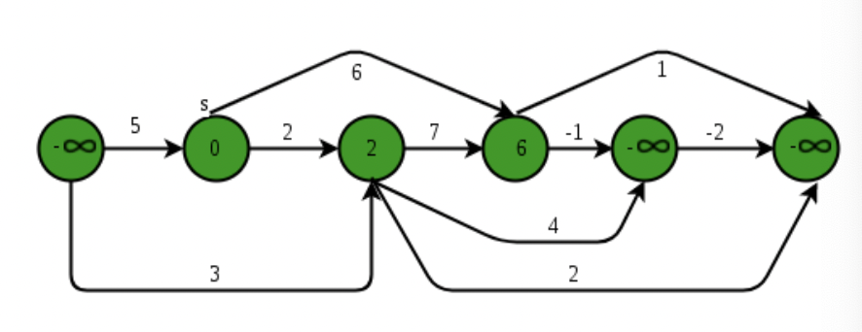

Slide 28
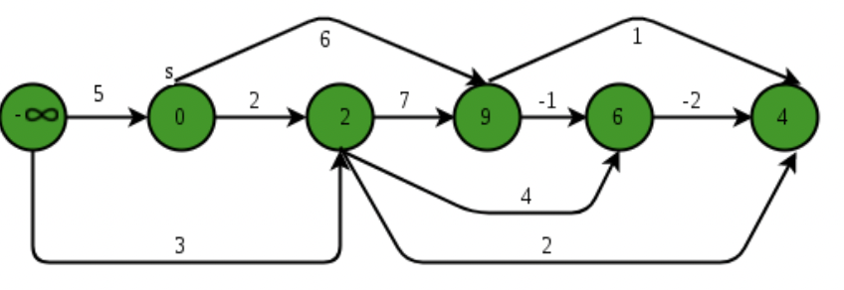

Slide 29
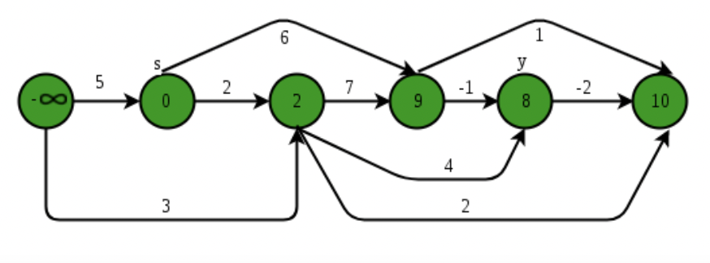

Slide 30
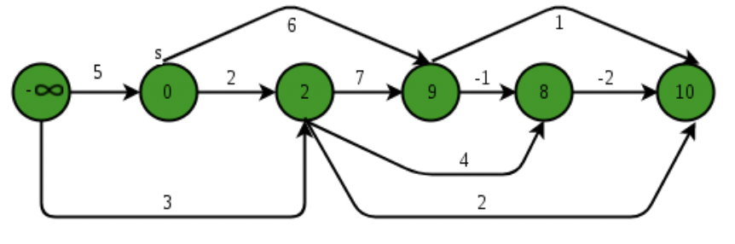

Slide 31
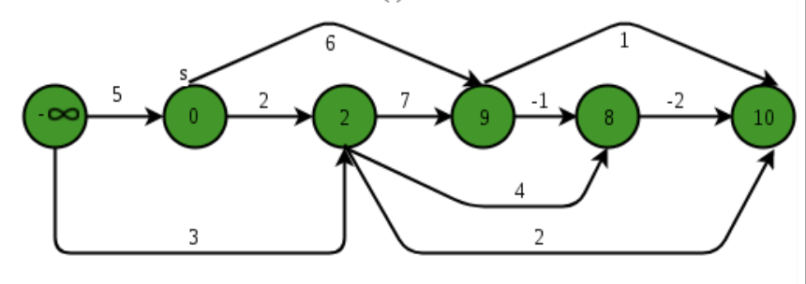

Slide 32
Homework
https://dmoj.ca/problem/cco15p2

Slide 33
Graph Theory Review
Methods of graph traversal
DFS, explores children recursively using a stack
BFS, explores graph by-layer using a queue. In an unweighted graph, BFS produces the shortest path
Single-source shortest path
Dijkstra’s algorithm, no negative cycles
Minimum spanning trees
Kruskal’s Algorithm with Union-find data structure
Prim’s Algorithm

Slide 34
Additional Practice
https://dmoj.ca/problem/graph1
Is the graph directed/undirected, weighted/unweighted?
How many accounts to disable if X and Y are (indirectly) friends? What if they’re not?
How do we solve this problem with graph traversal? Union-find data structure?

Slide 35
Additional Practice
https://dmoj.ca/problem/ccc13s4
How do we formulate this as a graph problem?
What are the vertices? Edges?
Is the graph directed/undirected, weighted/unweighted?
What does “taller” mean?

Slide 36
Additional Practice
https://dmoj.ca/problem/dmopc14c2p5
Is this graph directed/undirected, weighted/unweighted?
Is the graph cyclic? What’s its topological order?

Slide 37
Additional Practice
https://dmoj.ca/problem/cco11p2

